Slide 1
Maintenance Optimization
Understanding Optimization

Slide 2
Life Data Analysis
Understanding Weibull Analysis

Slide 3
An Overview of Basic Concepts
In life data analysis (also called "Weibull analysis"), the practitioner attempts to make predictions about the life of all products in the population.
The parameterized distribution for the data set can then be used to estimate important life characteristics of the product such as reliability or probability of failure at a specific time, the mean life and the failure rate.
Life data analysis requires the practitioner to:
Gather life data for the product.
Select a lifetime distribution that will fit the data and model the life of the product.
Estimate the parameters that will fit the distribution to the data.
Generate plots and results that estimate the life characteristics of the product, such as the reliability or mean life.

Slide 4
What’s the Weibull?- in English
The “Weibull “ refers to the Weibull statistical distribution, named after its “rediscoverer” Waloddi Weibull in the late 1940’s.
It provides a graphical solution to reliability questions even for small samples.
The Weibull distribution is used extensively in reliability engineering because of its ability to describe failure distributions from Early Life(infant morality) to Useful Life(random failures) to Wear out.
Examples include:
Early Life: Quality problems, assembly problems
Useful Life: foreign object damage, human error, quality or maintenance problems
Wear out: Low cycle fatigue, stress-rupture, corrosion

Slide 5

Lifetime Distributions
Statistical distributions have been formulated by statisticians, mathematicians and engineers to mathematically model or represent certain behaviour. The probability density function (pdf) is a mathematical function that describes the distribution.
The equation below gives the pdf for the 3-parameter Weibull distribution.
Some distributions, such as the Weibull and lognormal, tend to better represent life data and are commonly called "lifetime distributions" or "life distributions.“
Other commonly used life distributions include the exponential, lognormal and normal distributions. The analyst chooses the life distribution that is most appropriate to model each particular data set based on past experience and goodness-of-fit tests.

Slide 6
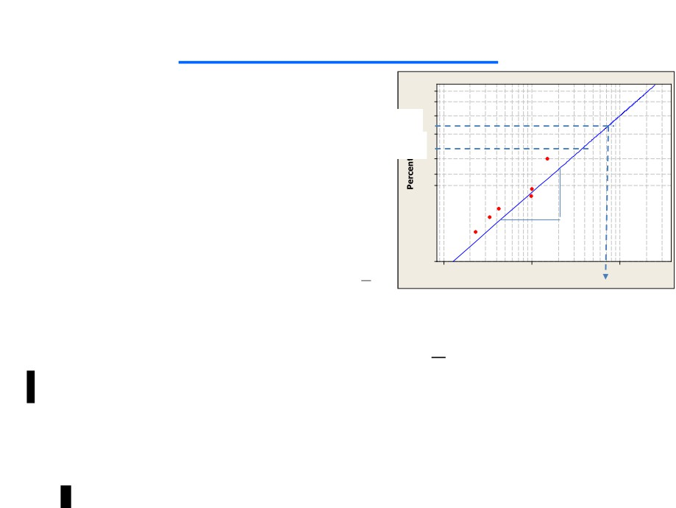

Weibull Definitions
η (Eta)= characteristic Life
≈ mean time to failure
β (Beta) = “slope” of line
≈ failure mode type
Weibull equation:
Cumulative % failed =
If t=η:
Cumulative % failed (at t=η)=(1−1 ) x100%=63.2%
e
Bxx life=age at which xx% of the fleet fail
B1 life= age at which 1% of the fleet fail
B10 life= age at which 10% of the fleet fail
95
80
63.2%
50
B10
20
5
2
Δy
1
$$1−ⅇ^{−{\left(\frac{t}{n}\right)}^{β}}$$
Δx
0.01
100 1000 10000
Time(hrs)
η

Slide 7
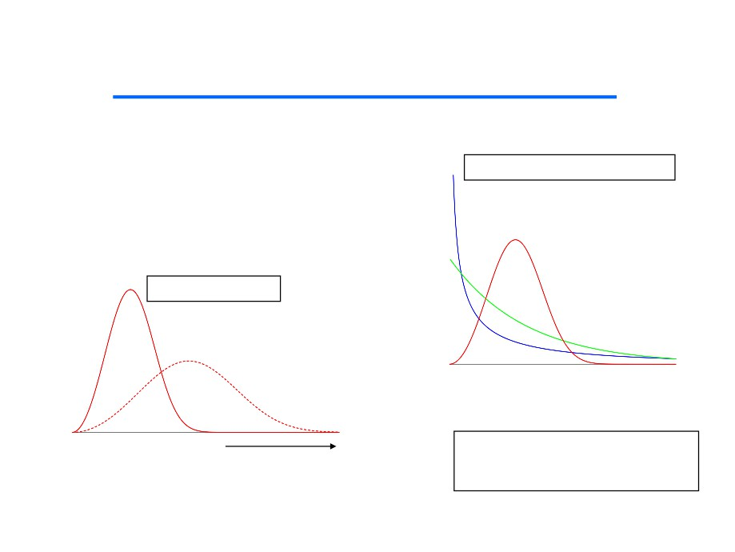
β and η makes the Weibull work
The Weibull distribution is characterized by two
parameters, a shape parameter we refer to as beta
(β ) and a scale parameter we refer to as eta (η )
Beta determines the PDF shape
Beta = . 5
Beta = 3
Eta scales the PDF
Beta = 1
Multiplying Eta by 2 Stretches the Scale by 2X But Keeps Area Under Curve Equal to 1
Beta and Eta are calculated to best
match the frequency, or density of data
point occurrence along the x-axis

Slide 8
Calculated Results and Plots
Once you have calculated the parameters to fit a life distribution to a particular data set, you can obtain a variety of plots and calculated results from the analysis, including:
Reliability Given Time: The probability that a unit will operate successfully at a particular point in time. For example, there is an 88% chance that the product will operate successfully after 3 years of operation.
Probability of Failure Given Time: The probability that a unit will be failed at a particular point in time. Probability of failure is also known as "unreliability" and it is the reciprocal of the reliability. For example, there is a 12% chance that the unit will be failed after 3 years of operation (probability of failure or unreliability) and an 88% chance that it will operate successfully (reliability).
Mean Life: The average time that the units in the population are expected to operate before failure. This metric is often referred to as "mean time to failure" (MTTF) or "mean time before failure" (MTBF).
Failure Rate: The number of failures per unit time that can be expected to occur for the product.
Reliable Life (warranty time). The estimated time when the reliability will be equal to a specified goal. For example, the estimated time of operation is 4 years for a reliability of 90%.

Slide 9
Calculated Results and Plots
B(X) Life: The estimated time when the probability of failure will reach a specified point (X%). For example, if 10% of the products are expected to fail by 4 years of operation, then the B(10) life is 4 years. (Note that this is equivalent to a reliable life of 4 years for a 90% reliability.)
Probability Plot: A plot of the probability of failure over time. (Note that probability plots are based on the linearization of a specific distribution. Consequently, the form of a probability plot for one distribution will be different than the form for another. For example, an exponential distribution probability plot has different axes than those of a normal distribution probability plot.)
Reliability vs. Time Plot: A plot of the reliability over time.
pdf Plot: A plot of the probability density function (pdf).
Failure Rate vs. Time Plot: A plot of the failure rate over time.
Contour Plot: A graphical representation of the possible solutions to the likelihood ratio equation. This is employed to make comparisons between two different data sets.

Slide 10
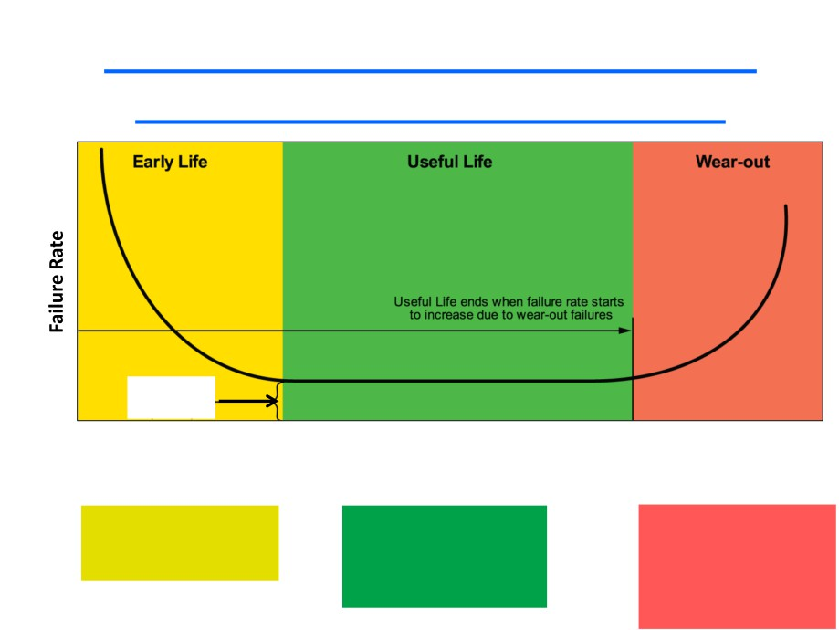
Bathtub curve
The Weibull Distribution can describe each portion of the Bathtub curve
β < 1
β = 1
β > 1
Steady State
Failure rate
Operating Time (hours, cycles, months, seconds)
Typical failure modes:
Typical failure modes
Typical failure modes:
* Inadequate burn-in
* Independent of time
* LCF
* Misassembly
* Maintenance errors
* TMF
* Some quality problems
* Electronics
* HCF
* Mixtures of problems
* Stress rupture
* Corrosion

Slide 11
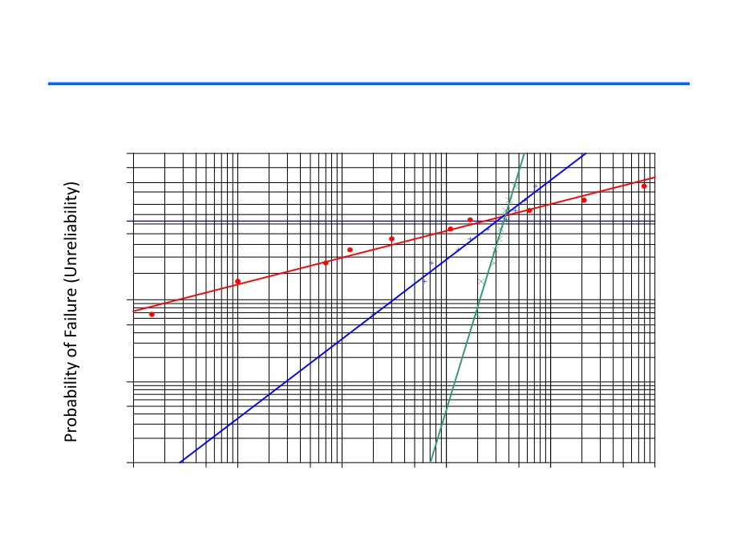
What Weibull β & η looks like on a Weibull Plot
β > 1
β = 1
99.9
99.0
β < 1
90.0
η
70.0
50.0
10.0
5.0
1.0
0.5
0.1
1.00E-2 .10
1.00 10.00
100.00 1000.00
Time (hours, months, cycles, seconds)
Note: SAS Weibull plot

Slide 12
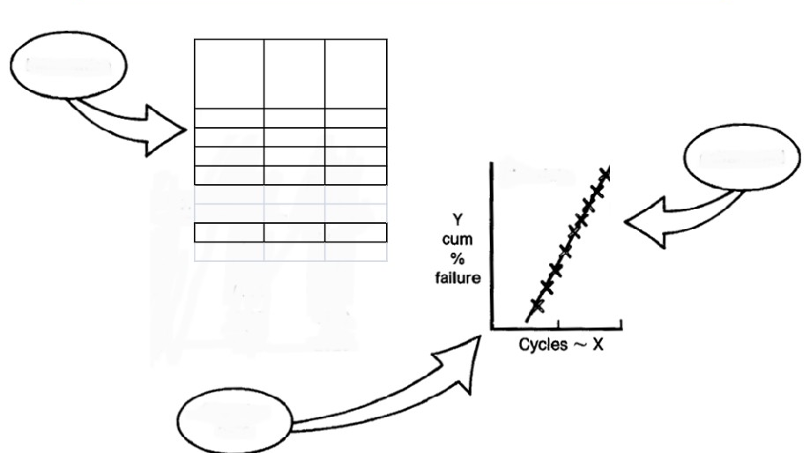
How is a Weibull Analysis done?
Organize
the Data
Failure
Time- Median
Cycles (X) Order Rank (Y)
910 1 0.061
976 2 0.149
Fit line
1125 3 0.237
to data
1532 4 0.325
¦ ¦ ¦
¦ ¦ ¦
3680 11 0.939
N=11
Plot the
Data

Slide 13
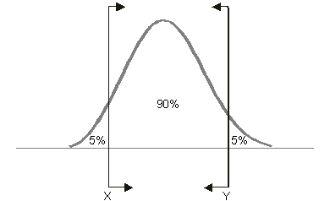
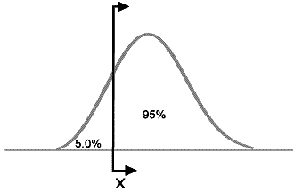
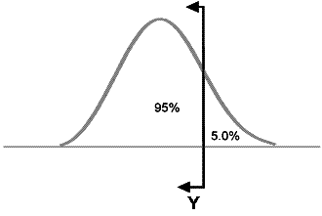
Confidence Bounds
Because life data analysis results are estimates based on the observed lifetimes of a sampling of units, there is uncertainty in the results due to the limited sample sizes.
"Confidence bounds" (also called "confidence intervals") are used to quantify this uncertainty due to sampling error by expressing the confidence that a specific interval contains the quantity of interest.
Two-Sided Confidence Bounds
Lower One-Sided Confidence Bounds
Upper One-Sided Confidence Bounds

Slide 14
Example Weibull Analysis
We will now use an example to show how Weibull analysis can:
Indicate what type of failure mode is seen
Substantiate a design (or not)
Forecast failures
Evaluate corrective actions

Slide 15
Examples
The following are examples of engineering problems solved with Weibull analysis:
• A project engineer reports three failures of a component in service operations during a three-month period. The Program Manager asks, "How many failures will we have in the next quarter, six months, and year?" What will it cost? What is the best corrective action to reduce the risk and losses?
• To order spare parts and schedule maintenance labor, how many units will be returned to depot for overhaul for each failure mode month-by-month next year? The program manager wants to be 95% confident that he will have enough spare parts and labor available to support the overall program.
• A state Air Resources Board requires a fleet recall when any part in the emissions system exceeds a 4% failure rate during the warranty period. Based on the warranty data, which parts will exceed the 4% rate and on what date?
• After an engineering change, how many units must be tested for how long, without any failures, to verify that the old failure mode is eliminated, or significantly improved with 90% confidence?
• An electric utility is plagued with outages from superheater tube failures. Based on inspection data forecast the life of the boiler based on plugging failed tubes. The boiler is replaced when 10% of the tubes have been plugged due to failure.
• The cost of an unplanned failure for a component, subject to a wear out failure mode, is twenty times the cost of a planned replacement. What is the optimal replacement interval?

Slide 16
Example Weibull Analysis
Field failure of a bearing cage occurred at times: 230,334, 423, 990, 1009, & 1510 hours.*
With an un failed population of over 1700 bearing cages:
Is the demonstrated B10 life ≥ 8000 hours?
If not:
How many failures will occur by 1000 hours? 4000 hours? (With no inspection)
How many failures will occur by 4000 hours if we initiated a 1000 hour inspection?
With a utilization rate of 25 hours per month, how many failures can you expect in the next year?
If we must redesign, how many bearing cages must I test for how long to be 90% confident I have a B10 life of 8000 hours?
* Data taken from USAF Weibull Analysis Handbook

Slide 17
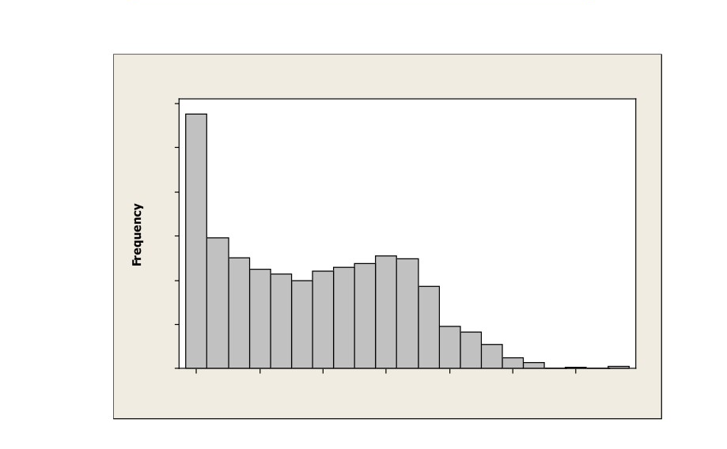
Example Weibull Analysis
• Bearing cage population:
Histogram of Time(hrs)
300 288
250
200
150
148
125
128 124
112
107
114 119 110
100
99
93
50
47
41
27
12 6
0 1 0 2
0
50 350
650
950 1250
1550
1850
Time(hrs)

Slide 18
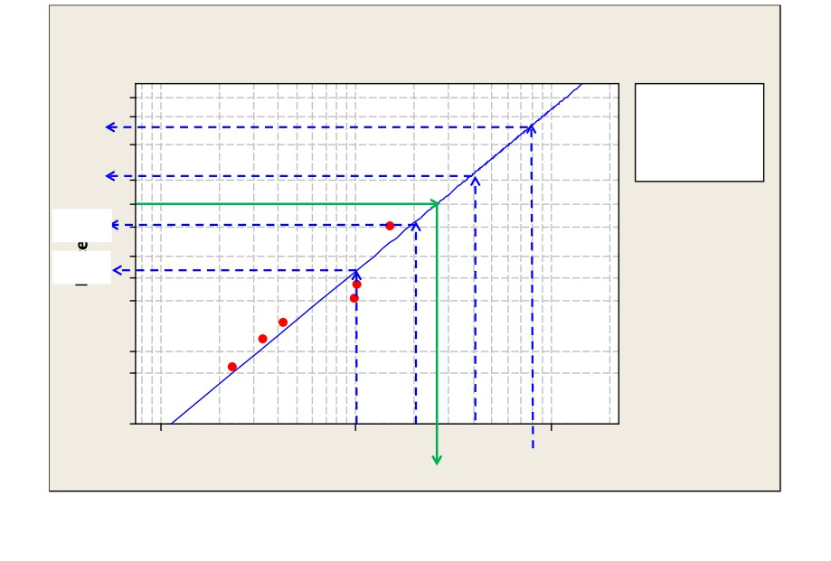
Example Weibull Analysis
Weibull Plot of Bearing Cage fractures
LSXY Estimates
95
Table of Statistics Beta 2.20068
70%
80
E ta 7333.21
50
Failure 6
Censor 1703
23% 20
C orrelation 0.946
10
5.6% 5
1.2%
2
1
0.5
0.1
0.05
0.01
100 1000 2000 4000
10000
Time(hrs)
8000
2638
Note: MINITAB Weibull plot

Slide 19
Example Weibull Analysis-answers
Is the demonstrated B10 life ≥ 8000 hours?
Answer: Looking at the Weibull plot the answer is NO, the B10 life demonstrated is ~2638 hours.
Then:
How many failures will occur by 1000 hours? 4000 hours? (With no inspection)
Answer: (Assuming failed units are not replaced)
Number of failed units by 1000 hours=Prob of Failure by 1000 hours X number of units = .012 x 1703= 21
How many failures will occur by 4000 hours if we initiated a 1000 hour inspection?
Answer: Each unit would cycle through 4 times, so, by 4000 hours (.012+.012+.012+.012) x (1703)=82 failures are expected.

Slide 20
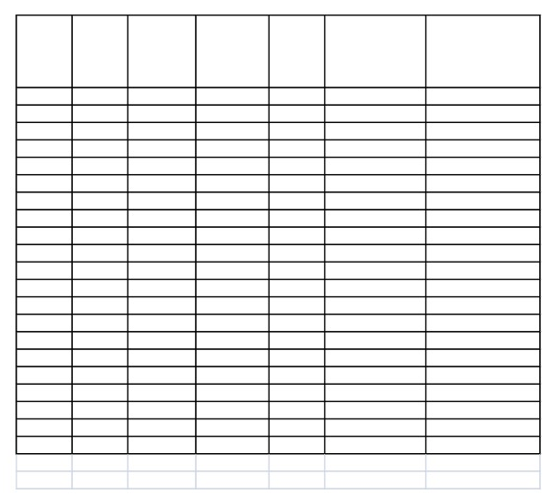
Example Weibull Analysis-answers
- With a utilization rate of 25 hours per month, how many failures can you expect in the next year?
Current Time on
Number time on each unit at of units each end of
Single unit risk: Total risk:
- Answer: (using EXCEL)
(F(t+300)-F(t))/ n*(F(t+300)-F(t))/ (1-
(n) unit(t) year(t+300)
F(t) F(t+300) (1-F(t)) F(t))
289
50
350
0.0000
0.0012
0.0012
0.35
149
150
450
0.0002
0.0022
0.0020
0.29
125
250
550
0.0006
0.0033
0.0028
0.34
112
350
650
0.0012
0.0048
0.0036
0.40
107
450
750
0.0022
0.0066
0.0045
0.48
98
550
850
0.0033
0.0087
0.0054
0.53
110
650
950
0.0048
0.0111
0.0063
0.69
114
750
1050
0.0066
0.0138
0.0072
0.83
118
850
1150
0.0087
0.0168
0.0082
0.97
128
950
1250
0.0111
0.0202
0.0092
1.18
124
1050
1350
0.0138
0.0239
0.0102
1.27
93
1150
1450
0.0168
0.0279
0.0112
1.04
47
1250
1550
0.0202
0.0322
0.0123
0.58
41
1350
1650
0.0239
0.0369
0.0133
0.55
27
1450
1750
0.0279
0.0419
0.0144
0.39
12
1550
1850
0.0322
0.0472
0.0155
0.19
6
1650
1950
0.0369
0.0528
0.0165
0.10
0
1750
2050
0.0419
0.0588
0.0176
0.00
1
1850
2150
0.0472
0.0650
0.0188
0.02
0
1950
2250
0.0528
0.0716
0.0199
0.00
2
2050
2350
0.0588
0.0785
0.0210
0.04
Overall fleet risk=
10.23

Slide 21
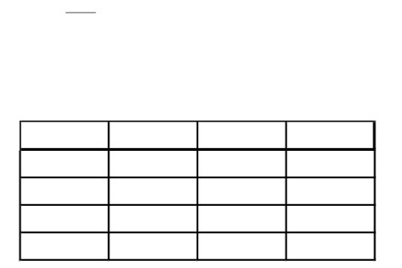
Example Weibull Analysis-answers
If we must redesign, how many bearing cages must I test for how long to be 90% confident I have a B10 life of 8000 hours?
Answer: based on a β=2.2, we can use the table on the next page to calculate the factor to multiply the characteristic life of the distribution we need to demonstrate with 90% confidence.
Since we know B10 life and β, we can calculate the η of the desired Weibull:
−(
8000
2.2
η
)
.10=1−e
⇒η=22, 250hours
- Hence, we could choose any number of test units(depending on budget):
- For example, I chose 2,3,4,or 5 new design bearing cages:
N
Multiplier
η
Test time
2
1.066134
22250
23721.48
3
0.886687
22250
19728.78
4
0.778
22250
17310.51
5
0.702959
22250
15640.83

Slide 22
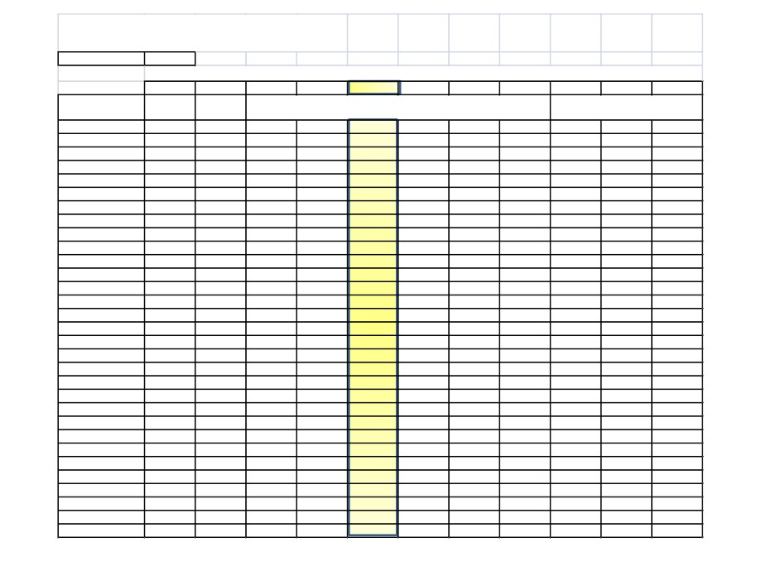
Zero-failure test Plans
Confidence level=
0.9
Beta
0.5
1
1.5
2
2.2
2.5
3
3.5
4
4.5
5
Infant
N
Mortality
Random
Early Wearout
Old Age Rapid Wearout
2
1.3255
1.1513
1.0985
1.0730
1.0661
1.0580
1.0481
1.0411
1.0358
1.0318
1.0286
3
0.5891
0.7675
0.8383
0.8761
0.8867
0.8996
0.9156
0.9272
0.9360
0.9429
0.9485
4
0.3314
0.5756
0.6920
0.7587
0.7780
0.8018
0.8319
0.8540
0.8710
0.8845
0.8954
5
0.2121
0.4605
0.5963
0.6786
0.7030
0.7333
0.7722
0.8013
0.8238
0.8417
0.8563
6
0.1473
0.3838
0.5281
0.6195
0.6471
0.6818
0.7267
0.7606
0.7871
0.8083
0.8257
7
0.1082
0.3289
0.4765
0.5735
0.6033
0.6410
0.6903
0.7278
0.7573
0.7811
0.8006
8
0.0828
0.2878
0.4359
0.5365
0.5677
0.6076
0.6603
0.7006
0.7325
0.7582
0.7795
9
0.0655
0.2558
0.4030
0.5058
0.5381
0.5797
0.6348
0.6774
0.7112
0.7386
0.7614
10
0.0530
0.2303
0.3757
0.4799
0.5130
0.5558
0.6129
0.6573
0.6927
0.7216
0.7455
11
0.0438
0.2093
0.3525
0.4575
0.4912
0.5350
0.5938
0.6397
0.6764
0.7064
0.7314
12
0.0368
0.1919
0.3327
0.4380
0.4722
0.5167
0.5768
0.6240
0.6618
0.6929
0.7188
13
0.0314
0.1771
0.3154
0.4209
0.4553
0.5004
0.5616
0.6098
0.6487
0.6807
0.7074
14
0.0271
0.1645
0.3002
0.4055
0.4402
0.4858
0.5479
0.5971
0.6368
0.6696
0.6970
15
0.0236
0.1535
0.2867
0.3918
0.4266
0.4726
0.5354
0.5854
0.6259
0.6594
0.6874
16
0.0207
0.1439
0.2746
0.3794
0.4143
0.4605
0.5240
0.5747
0.6159
0.6500
0.6786
17
0.0183
0.1354
0.2637
0.3680
0.4030
0.4495
0.5136
0.5649
0.6067
0.6413
0.6704
18
0.0164
0.1279
0.2539
0.3577
0.3927
0.4393
0.5039
0.5557
0.5980
0.6332
0.6628
19
0.0147
0.1212
0.2449
0.3481
0.3832
0.4299
0.4949
0.5472
0.5900
0.6256
0.6557
20
0.0133
0.1151
0.2367
0.3393
0.3743
0.4212
0.4865
0.5392
0.5825
0.6185
0.6490
21
0.0120
0.1096
0.2291
0.3311
0.3661
0.4130
0.4786
0.5318
0.5754
0.6119
0.6427
22
0.0110
0.1047
0.2221
0.3235
0.3585
0.4054
0.4713
0.5247
0.5688
0.6056
0.6367
23
0.0100
0.1001
0.2156
0.3164
0.3513
0.3983
0.4643
0.5181
0.5625
0.5996
0.6311
24
0.0092
0.0959
0.2096
0.3097
0.3446
0.3916
0.4578
0.5119
0.5565
0.5940
0.6258
25
0.0085
0.0921
0.2039
0.3035
0.3382
0.3852
0.4516
0.5059
0.5509
0.5886
0.6207
26
0.0078
0.0886
0.1987
0.2976
0.3323
0.3792
0.4457
0.5003
0.5455
0.5835
0.6158
27
0.0073
0.0853
0.1937
0.2920
0.3266
0.3735
0.4402
0.4949
0.5404
0.5786
0.6112
28
0.0068
0.0822
0.1891
0.2868
0.3213
0.3681
0.4349
0.4898
0.5355
0.5740
0.6068
29
0.0063
0.0794
0.1847
0.2818
0.3162
0.3630
0.4298
0.4849
0.5308
0.5695
0.6025
30
0.0059
0.0768
0.1806
0.2770
0.3113
0.3581
0.4250
0.4802
0.5263
0.5653
0.5984
40
0.0033
0.0576
0.1491
0.2399
0.2732
0.3192
0.3861
0.4423
0.4898
0.5302
0.5650
50
0.0021
0.0461
0.1285
0.2146
0.2468
0.2919
0.3584
0.4150
0.4632
0.5046
0.5403
Generated by EXCELTM

Slide 23
Weibull Analysis & the Reality of Data
• Failures only (perfect data…not the usual case)
• Censored (unfailed data along with failures) “Dirty” data:
Mixtures of failure modes
Curved data on Weibull plot
Nonzero time origin
No failure data
Interval inspection data
Failed units not identified
Unknown ages for successful units
Extremely small samples (as small as one failure)

Slide 24
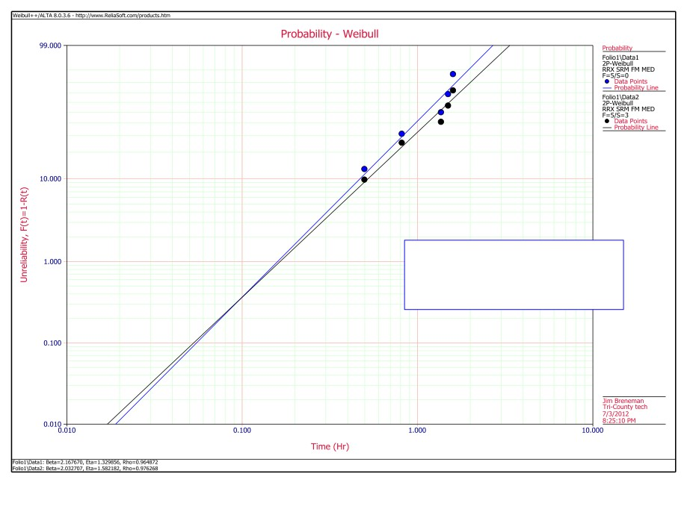
Bottom line: always use
suspensions(censored times) if you have them!!
Note: Weibull++8 Weibull plot

Slide 25
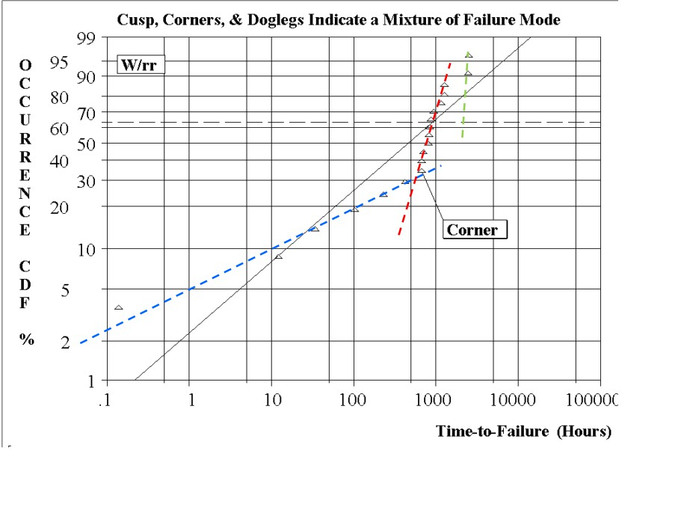
Note: Supersmith Weibull plot

Slide 26
Is Weibull for you?
If you have lab or field failures that you need to analytically determine:
What type of failure mode is it?
Are there more than one failure mode for this part?
How many more will I have? Next year? Next 2 years…?
How many of the new design should I test? For how long?
What happens if I wait to retrofit a new design until the MOH? Force retrofit?
How many spare parts do I need?
How much is the warranty going to cost us?
The answer is YES!
You can use the Weibull to help answer these questions!

Slide 27
Weibull in R

Slide 28
References
1. “USAF Weibull Analysis Handbook”, AFWAL-TR-
83-2079, 1983.
2. “The New Weibull Handbook”, Bob Abernethy,
Fifth Ed.
3. “Weibull Analysis Primer”, James McLinn, ASQ-RD 4.“A Statistical Distribution function of Wide
Applicability,” Waloddi Weibull, J. Appl. Mech, 18:293-297, 1951

Slide 29
Design Thinking
Ask the participants what kind of problems related to their industry can be solved using this concept.

Slide 30
Question & Answers

Slide 31
THANK YOU
Copyright © 2016 Defour Analytics Pvt. Ltd

